Slide 1
Fabric.js
Luke Sullivan

Slide 2
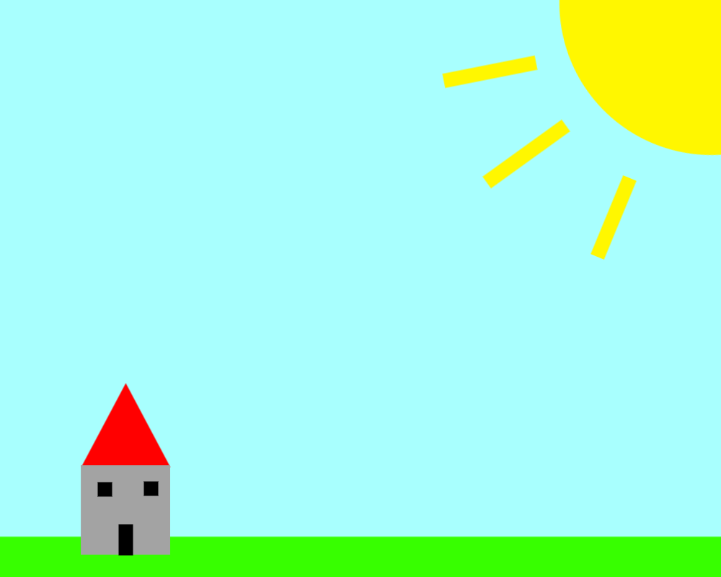
What is fabric.js?
Simplifies the process of creating and manipulating complex graphics on the web.
Canvas manipulation
OOP Model
API
Interactive Features
Serialization

Slide 3
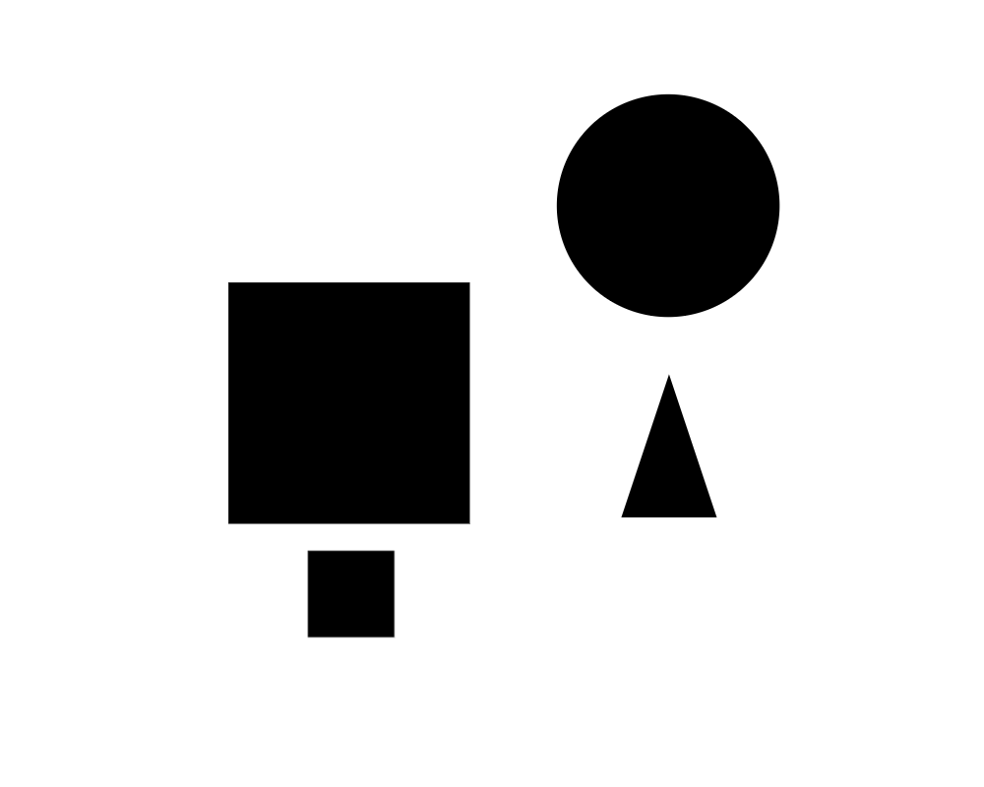
Why fabric.js?
Making “Paradise Notes” project in Agile course
Allows for user to take notes in an unstructured environment
Manipulate text objects
Input other elemental objects onto note environment
Save notes for later editing

Slide 4
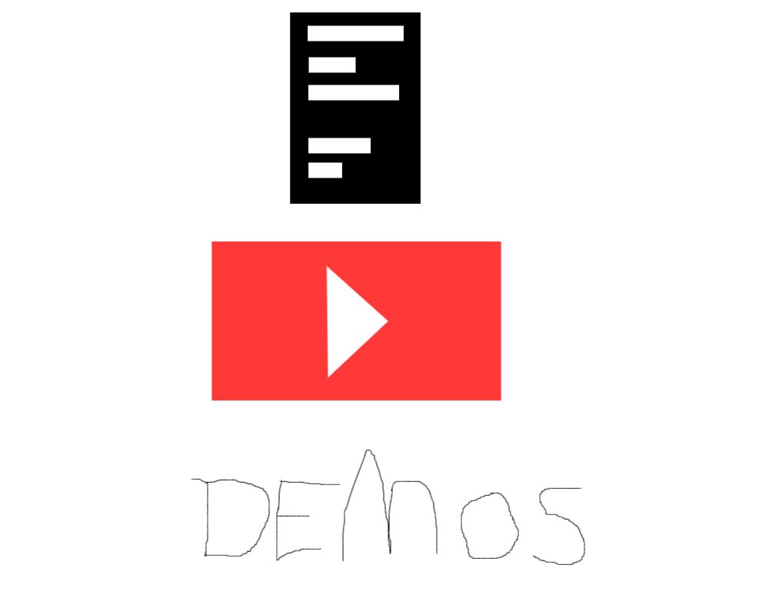
Learning Process
How:
Official fabric.js docs
Fabric.js Youtube tutorials
Fabric.js code demos
What:
Fabric.js API to manipulate canvas and shape objects

Slide 5
Individual Project - Public Canvas
Scope:
Canvas that allows users to add shapes and designs
Shape objects can be modified by color and size
Ability to clear canvas, undo and redo
Save canvas design and share image
Goals:
Aim to achieve a complete understanding of fabric.js shape objects and canvas manipulation
Demonstrate the usefulness of fabric.js and how it could be used for my Agile project.

Slide 6
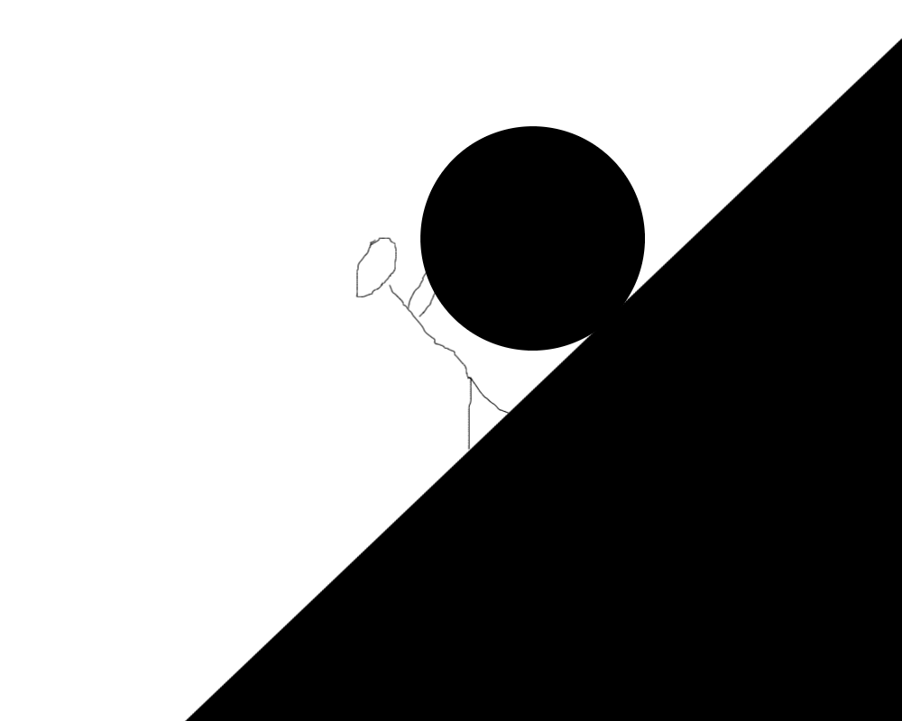
Challenges
Serialization and Saving
Save canvas design to web server to then display as a public catalog
Saving an image to database would make it not editable
Saving JSON to a database is not recommended for a relational database (Agile)
Fetch API

Slide 7
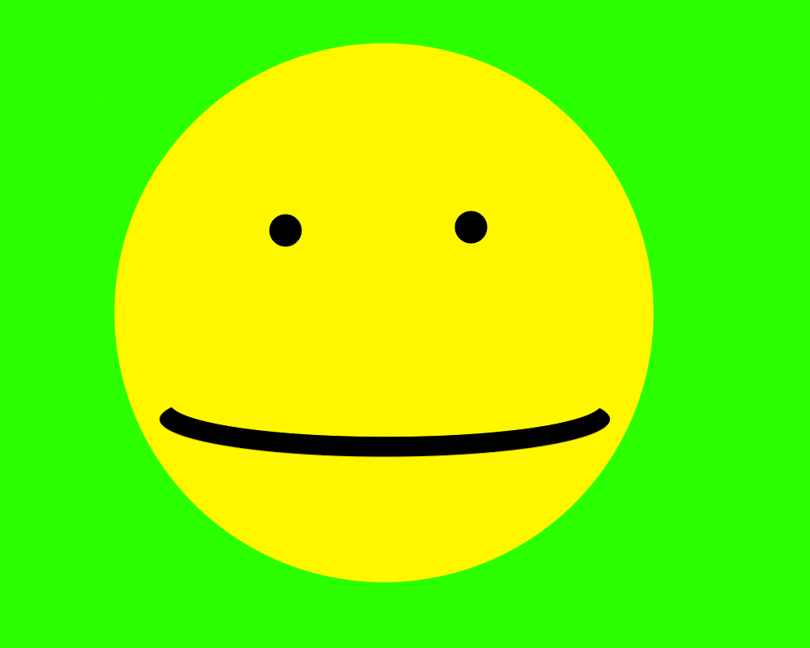
Future Opportunities & Agile Project
Paradise Notes
Explore using text with shape objects
Custom movement manipulation
Saving canvas to web server

